Slide 1


ORIGINS
Of EdTech
Mariana Ludmila Cortes
2021
One Laptop per Child

Slide 2

3,000,000 laptops

Slide 3

History

Slide 4
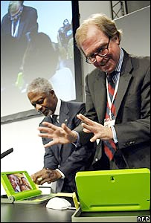
NICHOLAS NEGROPONTE from Theory to reality
Every child in developing countries has the same opportunities to access the world of learning through a low-cost laptop with connectivity
DAVOS 2005 - KOFI ANNAN Y NEGROPONTE launch OLPC

Slide 5
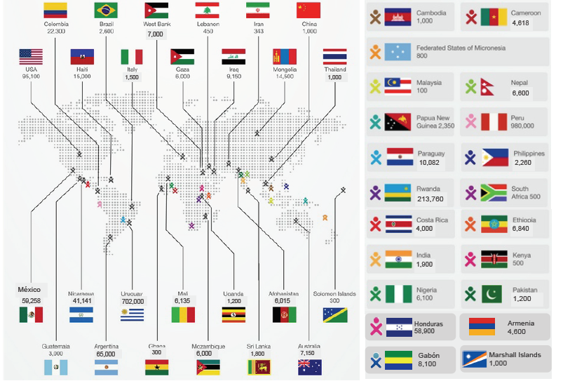

Slide 6
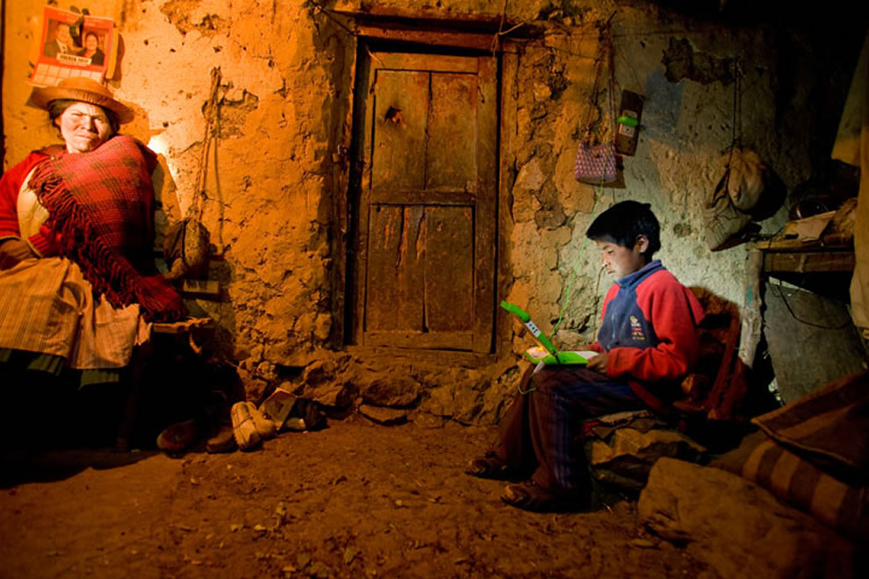

Slide 8
What do they have in common?
IA
Mathematics
Mathetic
Philosophy
Epistemology
Technology
EdTech
Programming
Coding
Lego
Learning
Makers Movement
Cognitive Science
OLPC

Slide 9

Notes:
The story of how those children got those computers really begins forty three years ago, in 1967, when a learning theorist named Seymour Papert suggested that every child in the world should have their own computer for learning.

Slide 10

What is ?
IA
Artificial Intelligence

Slide 11
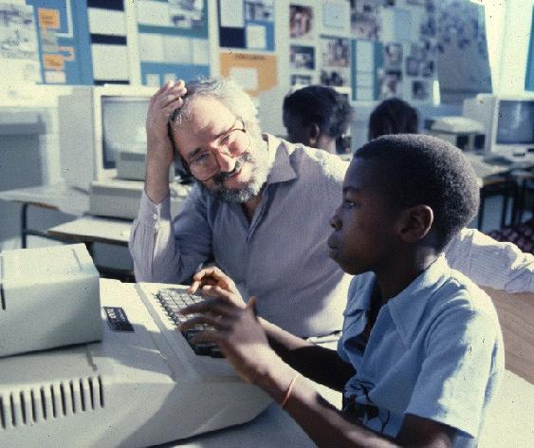
Senegal circa 1982
Notes:
Forty three years later, the idea is still crazy, but it is happening in many parts of the world, thanks to the effort of people like Papert and of his friend

Slide 13
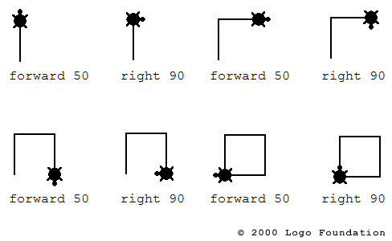

Slide 14
Papert
MATH vs. Mathematics

Slide 15
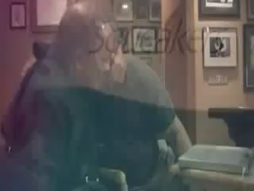

Slide 16
Notes:
called cheating is in school.
Sugar strives to bring out the positive potential of collaboration in school.) Learning
in a community lets every
child advance from simplicity to complexity in a natural way, because
every child has his or her
peers as scaffolding for advancement.

Slide 19

Debugging
Notes:
Programar con un lugar para hacer y re-hacer
to learn with the machine and software but also
to manipulate and
change the software and hardware itself opens the door to learning
lessons far more important
than those necessary to pass a test. It leads children to the
discovery that they are authentic
problem-solvers in the real world.

Slide 20
Thinking to think
Reflect
Problem solving
Comprehension
LEARNING
Notes:
collaborative learning - components of a strategy to expose children to multiple approachesto solving a problem.
multiple ways to solve problems
Marvin Minsky “Until you understand something more than one way, you don't really understand it.”

Slide 21
Notes:
“You learn things through doing, so if you want more
learning, you want more
doing.”

Slide 22
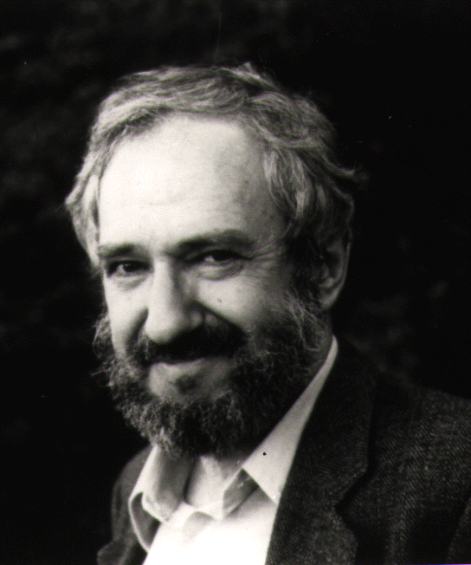


Slide 23
“LEARNING CAN ONLY HAPPEN WHEN A CHILD IS INTERESTED. IF HE’S NOT INTERESTED, IT’S LIKE THROWING MARSHMALLOWS AT HIS HEAD AND CALLING IT EATING.”
— KATRINA GUTLEBEN
Notes:
education done to the student.
alternative to passively knowledge:
Sugar - appropriate knowledge by putting it to work on problems that are meaningful to them.
As a consequence, learning is something done by the student

Slide 24
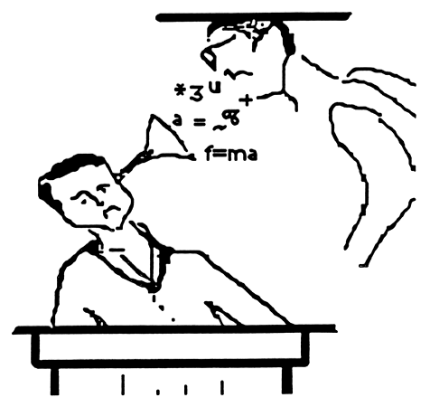
The mind is not a vessel to be filled
but a fire to be kindled.
- Plutarch -
Notes:
We continue teaching, rather than helping children learn and also learn-how-to-learn. A professor hammering abstract formulas of knowledge to

Slide 25
It is not about technology but what children can do with it.

Slide 26
Constructionism & powerful ideas
The central focus should not be on the machine, but on the mind.
If we focus on learning, the computer would be the means for each child to have the possibility of acquiring new knowledge about himself in the world around them, while gaining skills on the functioning of his mind.

Slide 27
... and thus, children become CREATORS rather than consumers of Educational Software.
Seymour Papert

Slide 28
CONSTRUCTIVISM
EdTech
LEGO Mindstorms
Coding
One Laptop per Child
MAKER movement
AI Lab - MIT
Seymour Papert

Slide 29
Have we achieved this or are we far from what the original intention was?

Slide 30
8 Powerful Ideas

Slide 31
1. Learning by doing

Slide 32
2. Technology as material to build/construct

Slide 34
3. Hard Fun

Slide 35
4. Learning to learn

Slide 36
Epistemology
Think about Thinking

Slide 37

You can't think about thinking without thinking
about thinking about something."-
Seymour Papert.

Slide 38
5. Take your time

Slide 39
6. You can only do things right if you have done things wrong.
Learn from mistakes

Slide 40
7. Do yourself what you want your children to do

Slide 41
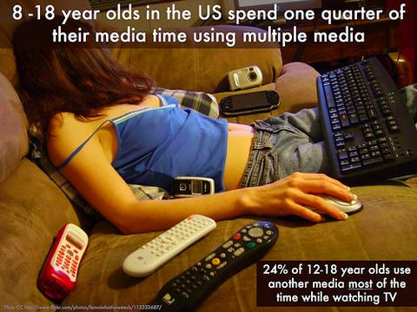
8. Digital Fluency

Slide 42
Computational thinking

Slide 43
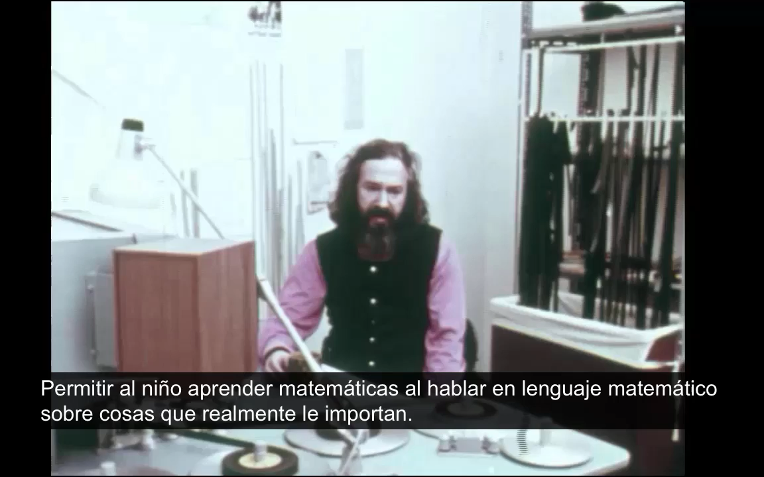

Slide 44
Notes:
“the teacher not impose
but a member of the community to
select the influences affect the child a The core idea driving Sugar development was the notion that children
and their teachers
can do more than just use a computer for information access; they can
use the computer as a
“thing to think with” to spark conceptual understanding, process, and
reasoning skills.

Slide 46
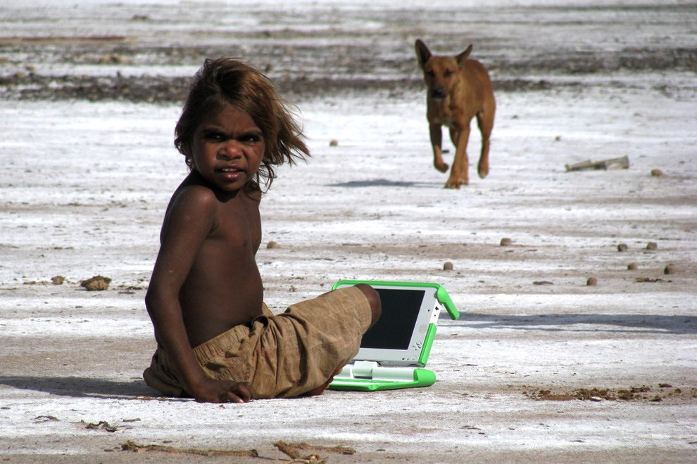
ANYWHERE,
ANYTIME,
ANYONE,
Be CREATIVE

